Slide 1

MARKETING ATTRIBUTION
Analyze Data with SQL
Lainnar Valencia Marin
July 12, 2023

Slide 2
Table of Contents
Company and marketing campaigns
What is the user journey?
How many first touches is each campaign responsible for?
How many last touches is each campaign responsible for?
How many visitors make a purchase?
How many last touches on the purchase page is each campaign responsible for?
What is the typical user journey?
CoolTShirts can re-invest in 5 campaigns. Which should they pick and why?

Slide 3
1. COMPANY AND MARKETING CAMPAIGN

Slide 4
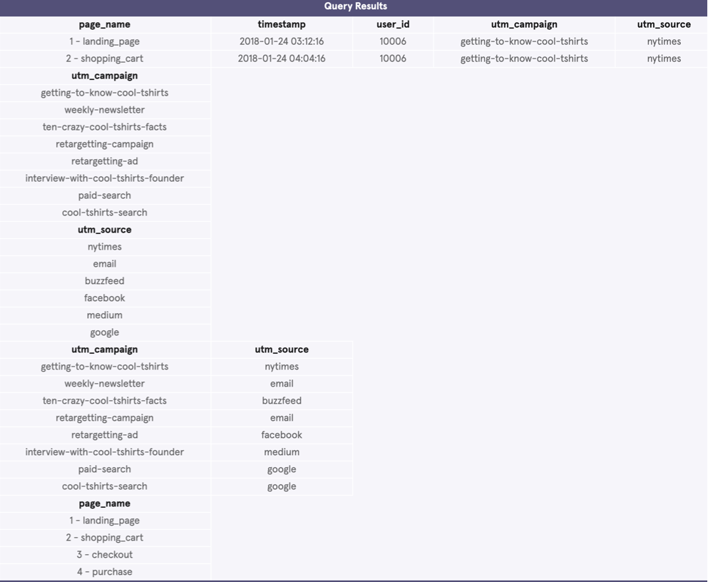
CoolTShirts
CoolTShirts is an innovative apparel shop running a bunch of marketing campaigns. This project will answer questions about how effective these campaigns are and some recommendations for the next round of campaigns.
Campaign information: the company is implementing eight campaigns and uses six sources. Every campaign uses a different source, except for the campaigns paid-search and cool-tshirts-search, which both use Google. The traffic of these campaigns are landing on four pages of CoolTShirts.
/*SQL CODE*/
SELECT *
FROM page_visits
LIMIT 2;
SELECT DISTINCT utm_campaign
FROM page_visits;
SELECT DISTINCT utm_source
FROM page_visits;
SELECT DISTINCT utm_campaign, utm_source
FROM page_visits;
SELECT DISTINCT page_name
FROM page_visits;

Slide 5
2. WHAT IS THE USER JOURNEY?

Slide 6
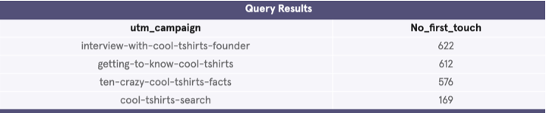
CoolTShirts
Campaign information: The following table shows the number of first touches each campaign is responsible for.
/*SQL CODE*/
WITH first_touch AS (
SELECT user_id,
MIN(timestamp) as first_touch_at
FROM page_visits
GROUP BY user_id), ft_2 AS(
SELECT ft.user_id,
ft.first_touch_at,
pv.utm_source,
pv.utm_campaign
FROM first_touch ft
JOIN page_visits pv
ON ft.user_id = pv.user_id
AND ft.first_touch_at = pv.timestamp)
SELECT ft_2.utm_campaign, COUNT(*) AS 'No_first_touch'
FROM ft_2
GROUP BY 1
ORDER BY 2 DESC;

Slide 7
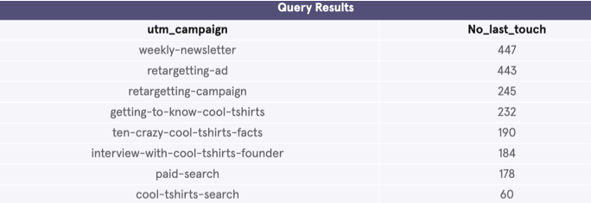
CoolTShirts
Campaign information: The following table shows how many last touches each campaign is responsible for.
/*SQL CODE*/
WITH last_touch AS (
SELECT user_id,
MAX(timestamp) as last_touch_at
FROM page_visits
GROUP BY user_id), ft_2 AS(
SELECT ft.user_id,
ft.last_touch_at,
pv.utm_source,
pv.utm_campaign
FROM last_touch ft
JOIN page_visits pv
ON ft.user_id = pv.user_id
AND ft.last_touch_at = pv.timestamp)
SELECT ft_2.utm_campaign, COUNT(*) AS 'No_last_touch'
FROM ft_2
GROUP BY 1
ORDER BY 2 DESC;

Slide 8
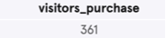
CoolTShirts
Campaign information: The following table shows how many visitors make a purchase.
/*SQL CODE*/
SELECT COUNT (DISTINCT user_id) AS 'visitors_purchase'
FROM page_visits
WHERE page_name = '4 - purchase';

Slide 9
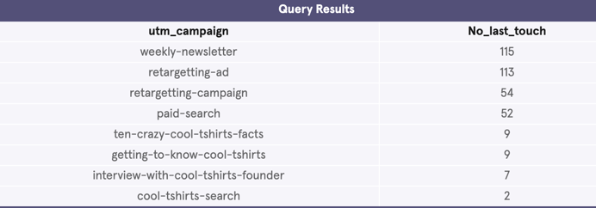
CoolTShirts
Campaign information: The following table shows how many last touches each campaign is responsible for on the purchase page.
/*SQL CODE*/
WITH last_touch AS (
SELECT user_id,
MAX(timestamp) as last_touch_at
FROM page_visits
WHERE page_name = '4 - purchase'
GROUP BY user_id), ft_2 AS(
SELECT ft.user_id,
ft.last_touch_at,
pv.utm_source,
pv.utm_campaign
FROM last_touch ft
JOIN page_visits pv
ON ft.user_id = pv.user_id
AND ft.last_touch_at = pv.timestamp)
SELECT ft_2.utm_campaign, COUNT(*) AS 'No_last_touch'
FROM ft_2
GROUP BY 1
ORDER BY 2 DESC;

Slide 10
3. WHAT IS THE USER JOURNEY?

Slide 11
Recommendation CoolTShirts Invesment
Since the company can only invest in 5 campaigns, my recommendation is to invest in (1) interview-with-cool-tshirts-founder, (2)retargetting-ad, (3)weekly-newsletter, (4)ten-crazy-cool-tshirts-facts and (5)
Getting-to-know-cool-tshirts. Because they generate 65% of sales.
/*SQL CODE*/
WITH first_touch AS (
SELECT user_id,
MIN(timestamp) as first_touch_at
FROM page_visits
GROUP BY user_id), ft_2 AS(
SELECT ft.user_id,
ft.first_touch_at,
pv.utm_source AS 'first_touch_utm_source',
pv.utm_campaign AS 'first_touch_utm_campaign'
FROM first_touch ft
JOIN page_visits pv
ON ft.user_id = pv.user_id
AND ft.first_touch_at = pv.timestamp),
last_touch AS (
SELECT user_id,
MAX(timestamp) as last_touch_at
FROM page_visits
WHERE page_name = '4 - purchase'
GROUP BY user_id), ft_3 AS(
SELECT lt.user_id,
lt.last_touch_at,
pv.utm_source as 'last_touch_utm_source',
pv.utm_campaign as 'last_touch_utm_campaign'
FROM last_touch lt
JOIN page_visits pv
ON lt.user_id = pv.user_id
AND lt.last_touch_at = pv.timestamp
)
SELECT first_touch_utm_campaign, last_touch_utm_campaign, COUNT(*)
FROM ft_2 JOIN ft_3 ON ft_2.user_id = ft_3.user_id
GROUP BY 1
ORDER BY 2 DESC;
Query Results
first_touch_utm_campaign | last_touch_utm_campaign | last_touch_purchase | Invest?
interview-with-cool-tshirts-founder | retargetting-ad | 38 | Yes
interview-with-cool-tshirts-founder | weekly-newsletter | 37 | Yes
ten-crazy-cool-tshirts-facts | weekly-newsletter | 36 | Yes
getting-to-know-cool-tshirts | retargetting-ad | 35 | Yes
ten-crazy-cool-tshirts-facts | retargetting-ad | 35 | Yes
getting-to-know-cool-tshirts | weekly-newsletter | 29 | Yes
interview-with-cool-tshirts-founder | paid-search | 19 | No
getting-to-know-cool-tshirts | retargetting-campaign | 18 | No
interview-with-cool-tshirts-founder | retargetting-campaign | 17 | No
ten-crazy-cool-tshirts-facts | paid-search | 16 | No
cool-tshirts-search | weekly-newsletter | 13 | No
ten-crazy-cool-tshirts-facts | retargetting-campaign | 13 | No
getting-to-know-cool-tshirts | paid-search | 12 | No
getting-to-know-cool-tshirts | getting-to-know-cool-tshirts | 8 | Yes
ten-crazy-cool-tshirts-facts | ten-crazy-cool-tshirts-facts | 8 | Yes
interview-with-cool-tshirts-founder | interview-with-cool-tshirts-founder | 7 | Yes
cool-tshirts-search | retargetting-campaign | 6 | NO
cool-tshirts-search | paid-search | 5 | NO
cool-tshirts-search | retargetting-ad | 5 | NO
cool-tshirts-search | cool-tshirts-search | 2 | NO
getting-to-know-cool-tshirts | ten-crazy-cool-tshirts-facts | 1 | Yes
ten-crazy-cool-tshirts-facts | getting-to-know-cool-tshirts | 1 | Yes
YES 235 65,10%
NO 126 34,90%
TOTAL 361 100,00%

